Slide 1
Photoelectric Questions from PPT

Slide 2
1. Calculate the wavelength of light, in nm, illuminating a barium surface if the threshold frequency of barium is 6.07 x 10¹⁴ Hz and the kinetic energy of the electron emitted is 1.31 x 10⁻¹⁸ J.
2. If barium has a threshold frequency of 6.07 x 10¹⁴ Hz, calculate the kinetic energy of the electron emitted when barium is illuminated with a wavelength of 385 nm.

Slide 3
3. Calculate the threshold wavelength, in nm, of a metal if that metal emits an electron with a kinetic energy of 6.32 x 10⁻¹⁹ J when illuminated with light that has a frequency of 1.97 x 10¹⁵ Hz.
4. Calculate the frequency of light illuminating a copper surface if the threshold frequency of copper is 1.08 x 10¹⁵ Hz and the velocity of the electron emitted is 1.11 x 10⁶ m/s.

Slide 4
5. An instrument is sensitive to light packets that carry at least 1.03 x 10⁻¹⁶ J of energy. How many photons of light of frequency of 3.02 x 10¹³ Hz can the instrument detect?
6. A laser emits a pulse of light containing 2.46 x 10⁻¹⁶ J of energy at a frequency of 3.25 x10¹⁴ Hz. How many photons are present in the pulse?
7. Calculate the threshold wavelength, in nm, of a metal if that metal emits an electron with a kinetic energy of 2.09 x 10⁻¹⁹ J when illuminated with light that has a frequency of 1.40 x 10¹⁵ Hz.

Slide 5
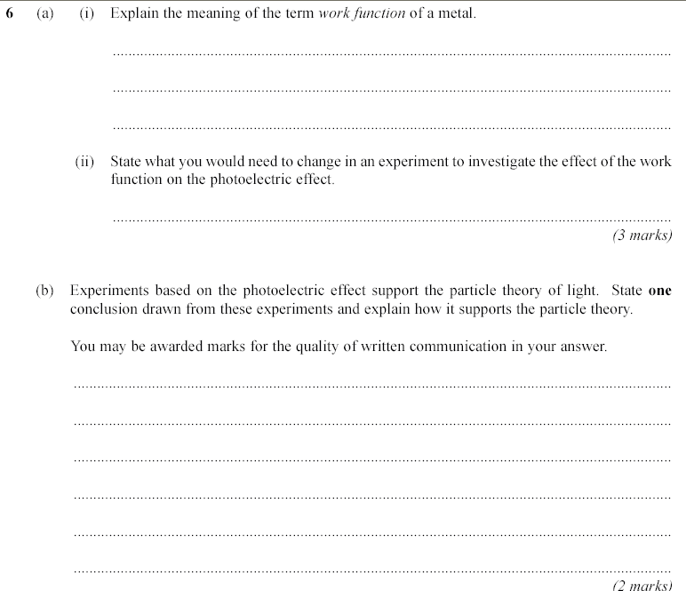

Slide 6
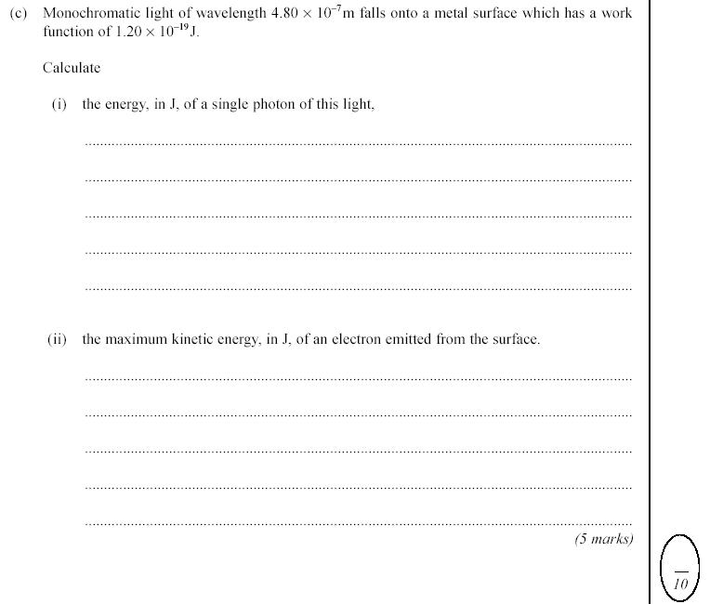

Slide 7
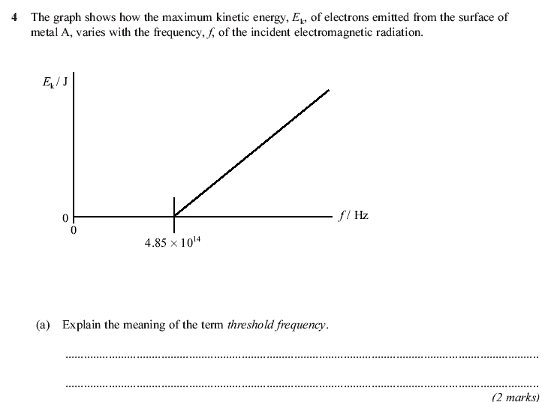

Slide 8
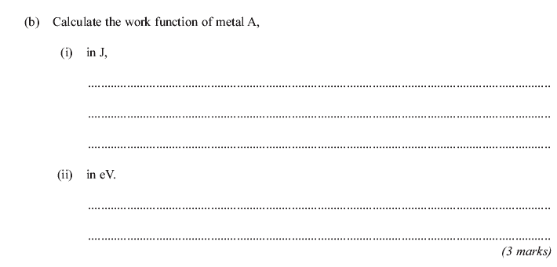

Slide 9
